Slide 1
2020 MMILAB.DIP Seminar Week4(7/23~7/30)
20151415 김성수

Slide 2
Contents
Thresholding
- Global Thresholding (Basic, Otsu)
- Improvement (Smoothing, Using Edges)
- Multiple Threshold
- Image Partitioning
- Variable Thresholding(Local image properties)
- Moving Average Thresholding
Morphological image processing
- Erosion, Dilation, Opening, Closing
- Boundary Extraction
- Hole filling

Slide 3
Contents
Hole filling
Super pixel

Slide 4
Huffman coding
= Coding algorithm to find minimum average bit length
Arrange symbols in decreasing order of (Think as nodes/leaves as a tree)
Merge 2 nodes with lowest probability
Assign 0/1 to top/ bottom branch
Read code form root-to- leave

Slide 5
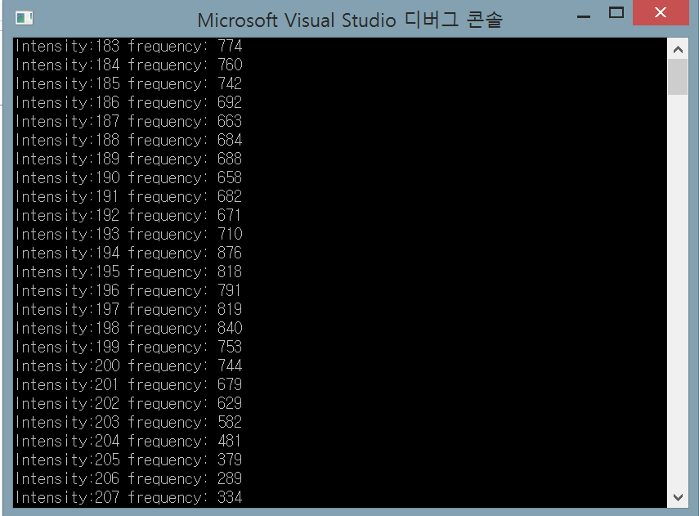
Huffman coding

Slide 6
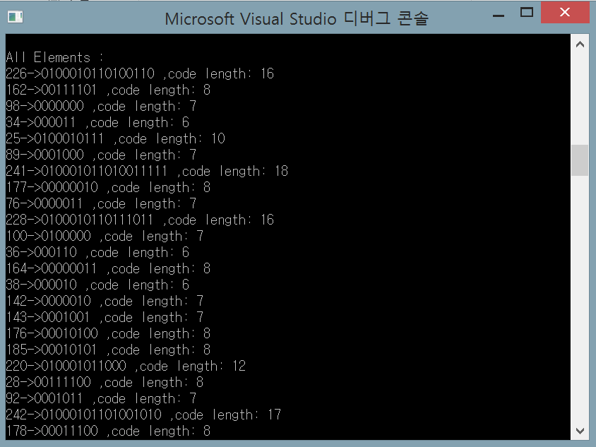
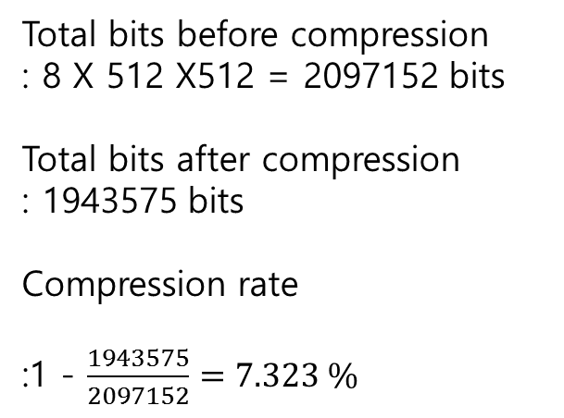
Huffman coding
Total bits before compression
: 8 X 512 X512 = 2097152 bits
Total bits after compression
: 1943575 bits
Compression rate
:1 - $\frac{1943575}{2097152}=7.323 \%$

Slide 7
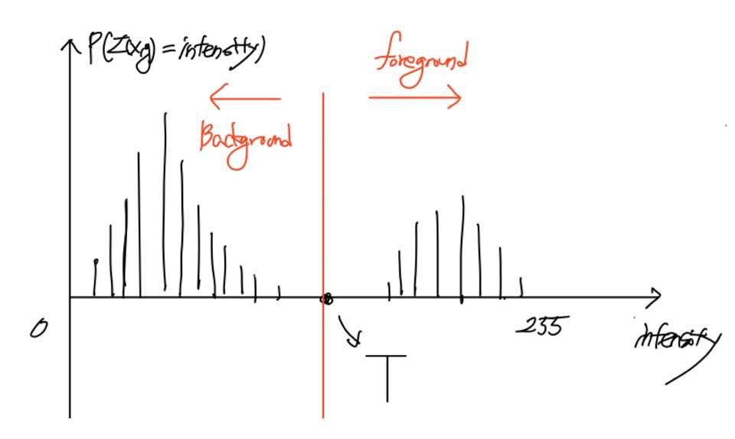

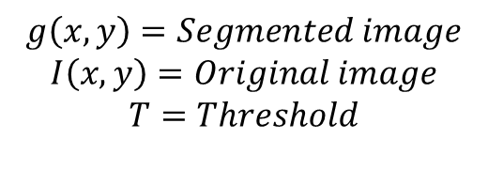
Thresholding
Thresholding : Image segmentation→ Seperating background and foreground
Histogram of image
How to choose T?
1. Try to choose T that works for entire image
(global threshold)
2. Choose local threshold
Noise can change
foreground and background of image
$$g\left(x,y\right)= \left\{\begin{aligned}1 if I\left(x,y\right)>T \\ 0 if I\left(x,y\right)≤T\end{aligned}\right.$$
$$g\left(x,y\right)=Segmented image$$
$$I\left(x,y\right)=Original image$$
$$T=Threshold$$

Slide 8
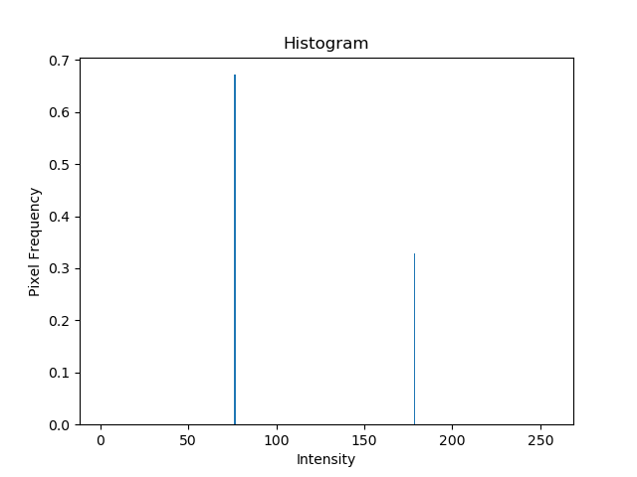
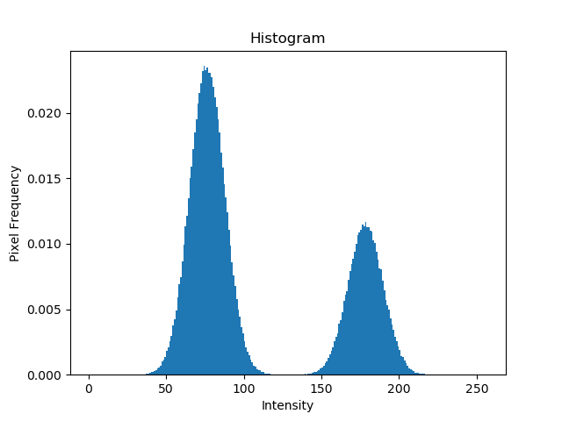
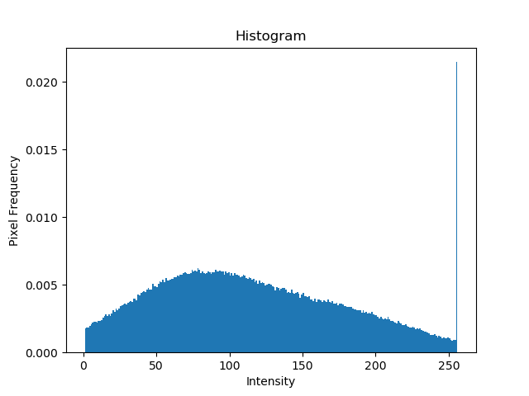
Effect of noise
Original
Mean = 0, Std = 10
Gaussian noise
Mean = 0, Std = 50
Gaussian noise

Slide 9
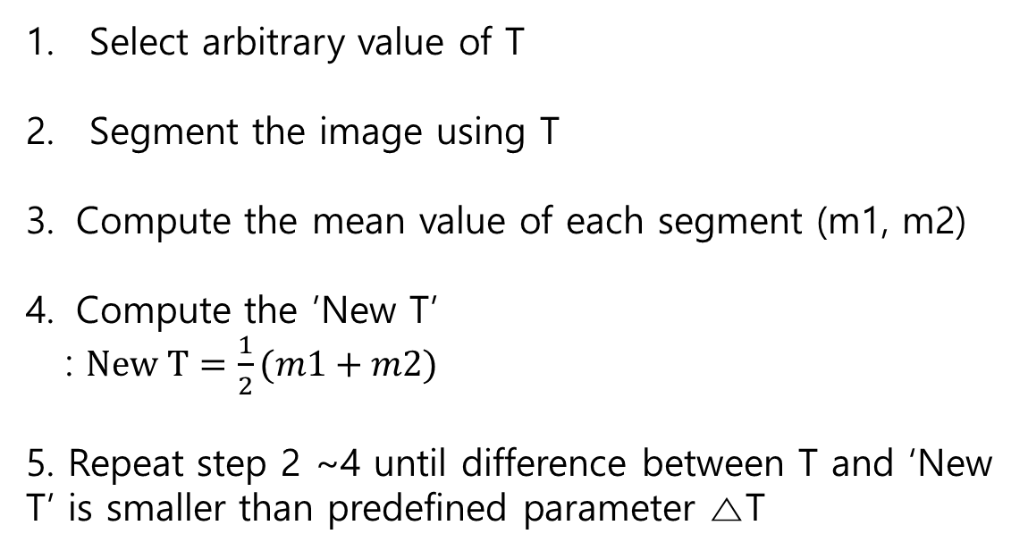
Basic Global Thresholding
Select arbitrary value of T
Segment the image using T
Compute the mean value of each segment (m1, m2)
Compute the ’New T’
: $New T=\frac{1}{2}(m1+m2)$
5. Repeat step 2 ~4 until difference between T and ‘New T’ is smaller than predefined parameter △T

Slide 10

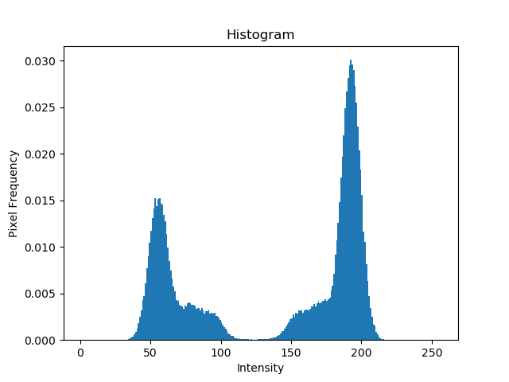
Basic Global Thresholding
Initial T = mean of entire image intensity, △T=0
Original
Histogram
T= 125.38

Slide 11
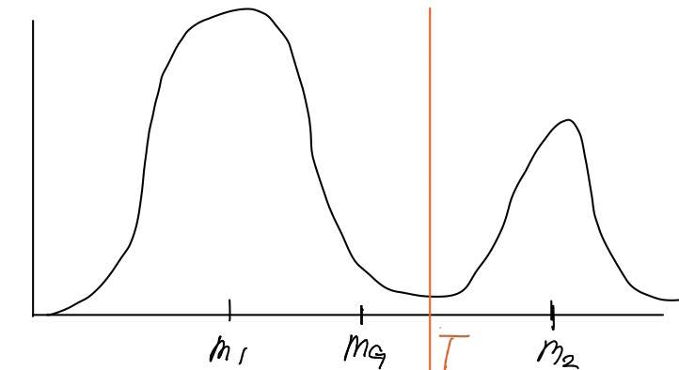
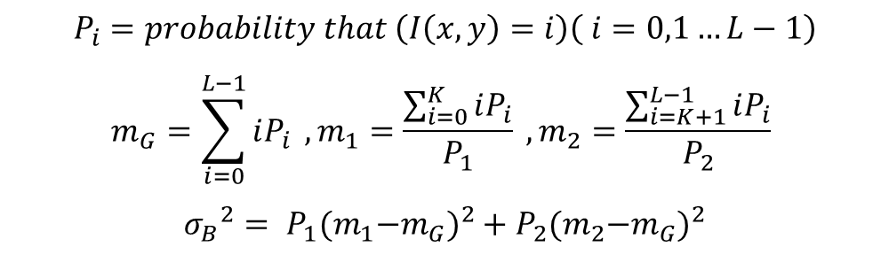
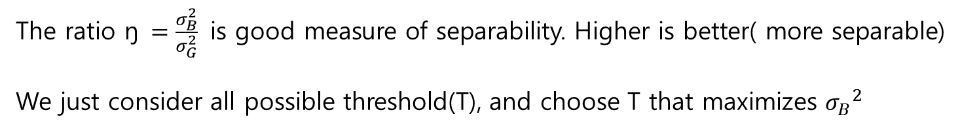
Otsu Algorithm
Class 1
Class 2
Idea : Maximize the between-class variance ${σ_{B}}_{ }^{2}$
Probability
$$P_{i}=probability that \left(I\left(x,y\right)=i\right)\left( i=0,1…L−1\right)$$
$$m_{G}=\sum_{i=0}^{L−1}{iP_{i}} ,m_{1}=\frac{\sum_{i=0}^{K}{iP_{i}}}{P_{1}} ,m_{2}=\frac{\sum_{i=K+1}^{L−1}{iP_{i}}}{P_{2}}$$
$${σ_{B}}_{ }^{2}= P_{1}{{(m}_{1}−m_{G})}^{2}+P_{2}{{(m}_{2}−m_{G})}^{2}$$
Intensity
The ratio ŋ $=\frac{σ_{B}^{2}}{σ_{G}^{2}}$ is good measure of separability. Higher is better( more separable)
We just consider all possible threshold(T), and choose T that maximizes ${σ_{B}}_{ }^{2}$

Slide 12
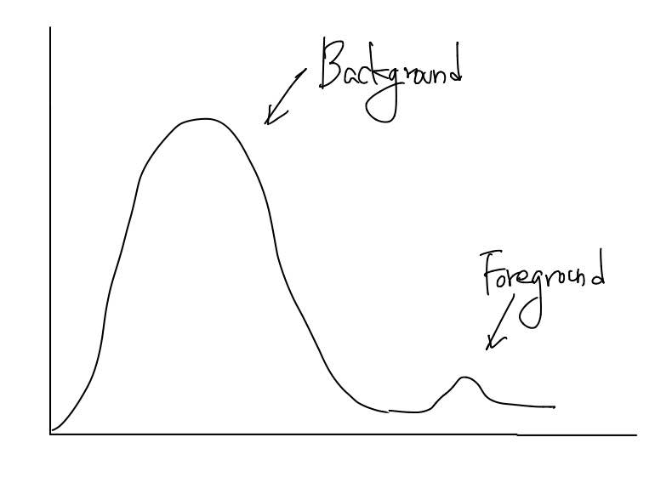
Otsu Algorithm
Otsu can fail when :
There is no strong peaks in histogram
Object is too small with respect to background
Remedies:
Apply low-pass filter to image, then apply otsu algorithm
Only consider pixels near edges when computing the threshold

Slide 13


Otsu Thresholding
Original
Basic global thresholding
T= 169.4
Otsu’s method
T = 182

Slide 14
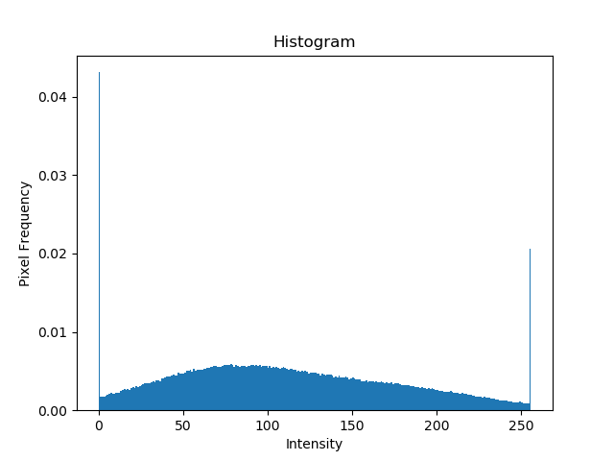

Improvement – Using Smoothing
Gaussian noise image
Histogram
Otsu (T_opt = 119, Sep= 0.69)

Slide 15
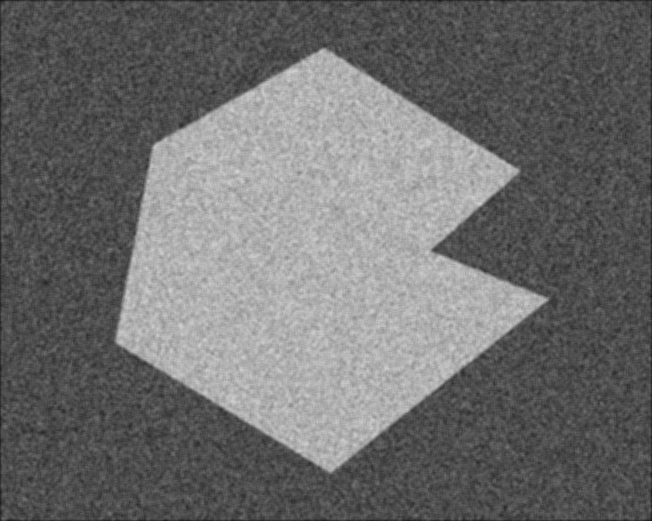
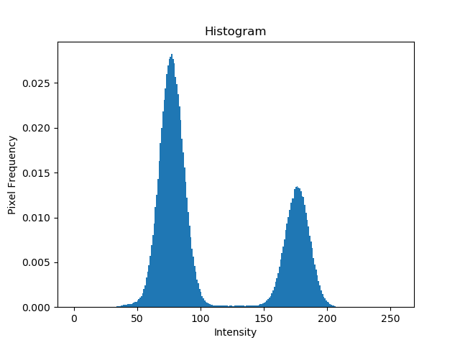

Improvement – Using Smoothing
5 X 5 smoothing image
Histogram
Otsu (T_opt = 127, Sep= 0.95)

Slide 16
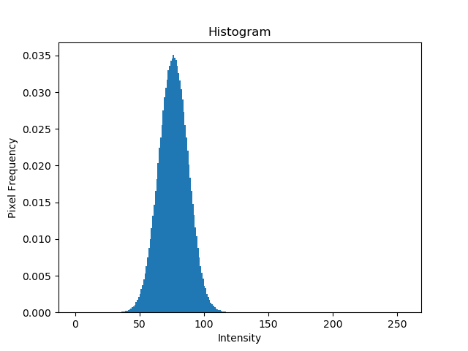
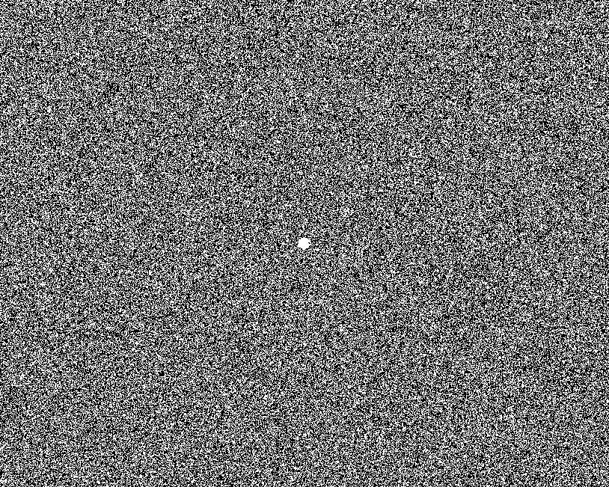
Improvement – Using Smoothing
Original
Histogram
Otsu (T_opt = 77, Sep= 0.62)

Slide 17
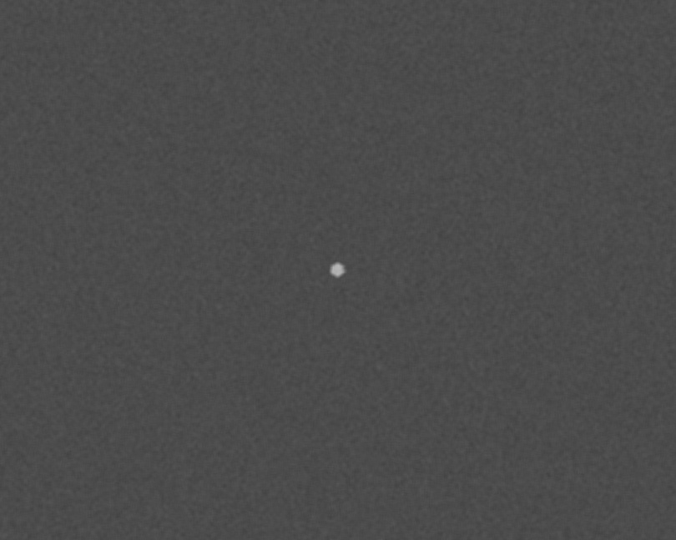
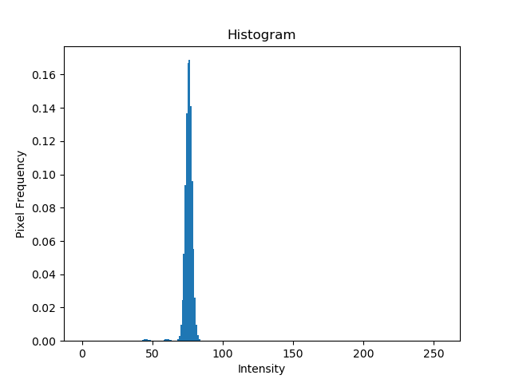
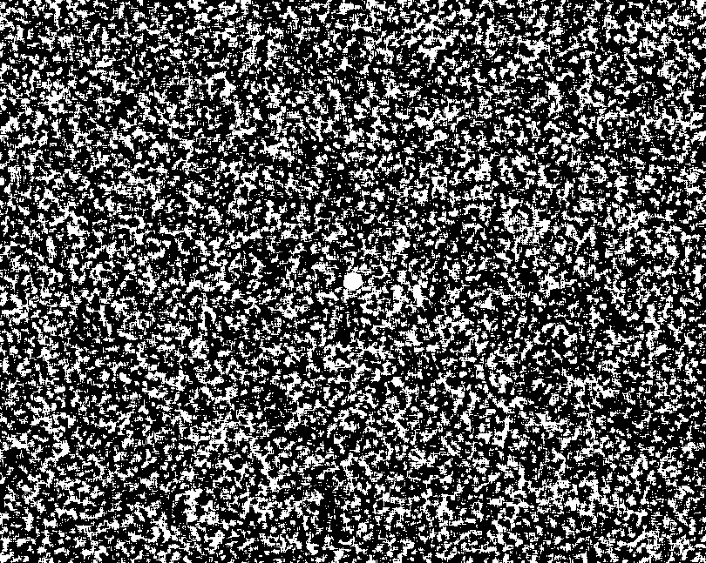
Improvement – Using Smoothing
5 X 5 smoothing image
Histogram
Otsu (T_opt = 76, Sep= 0.42)

Slide 18
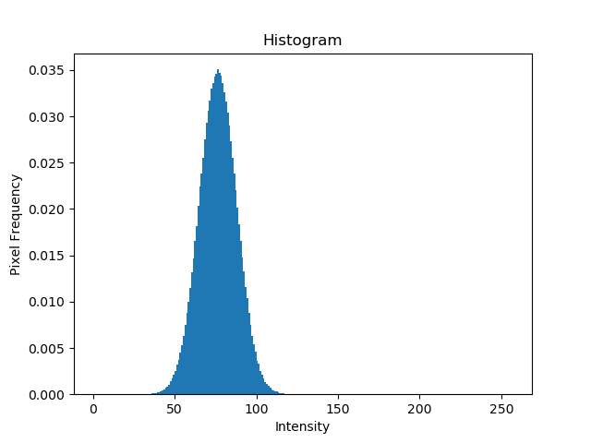
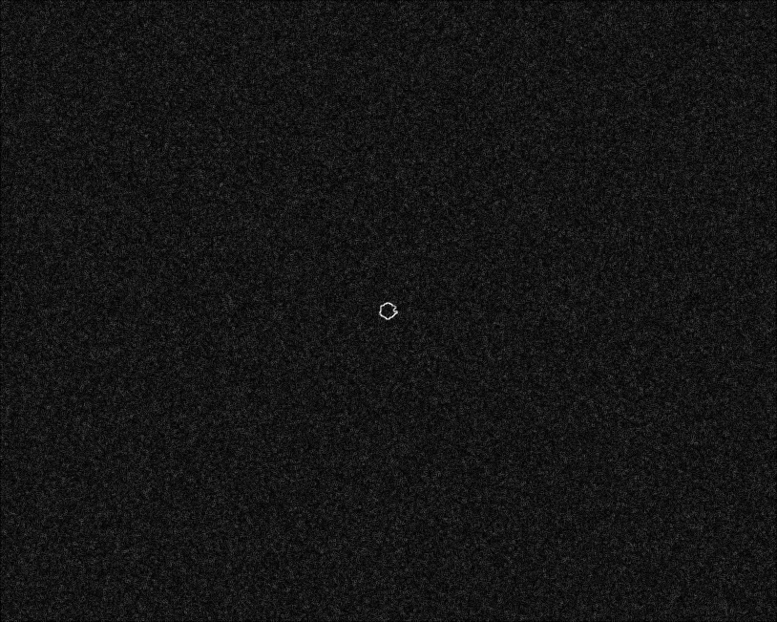
Improvement – Using Edges(Sobel)
Original
Histogram
Sobel (edge image)

Slide 19
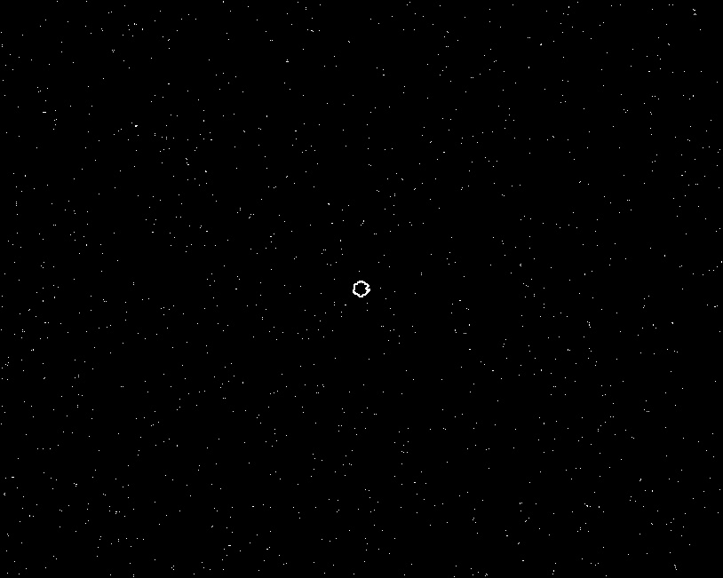
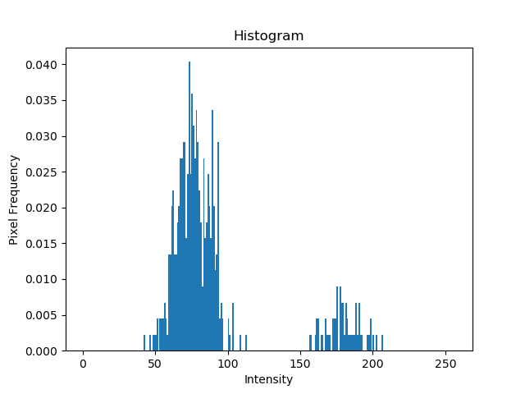

Improvement – Using Edges(Sobel)
Sobel (percentile 99.7 image)
Histogram
Otsu (T_opt = 129, Sep= 0.42)

Slide 20
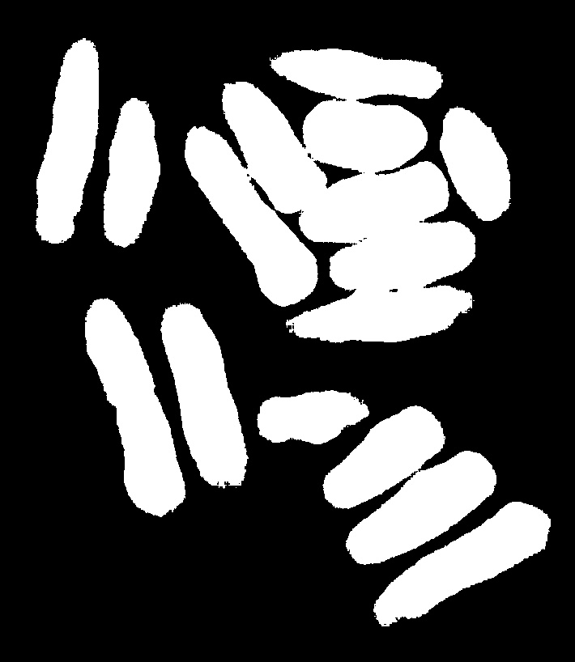
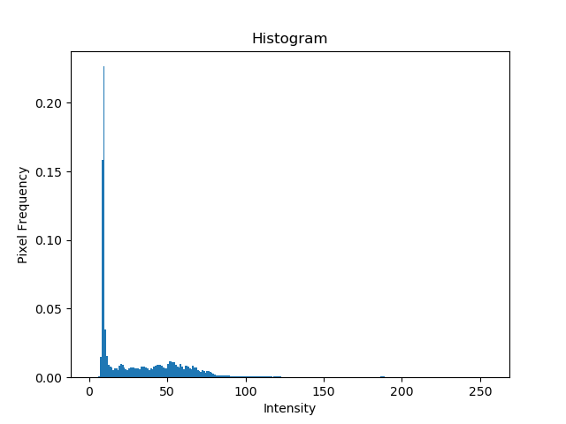
Improvement – Using Edges(Laplacian)
Original
Histogram
Otsu thresholding
( T=43, Sep =0.636)

Slide 21
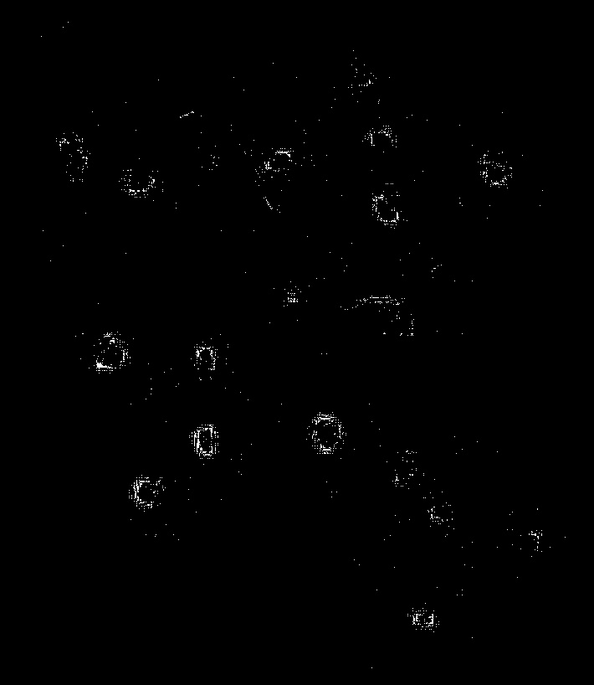
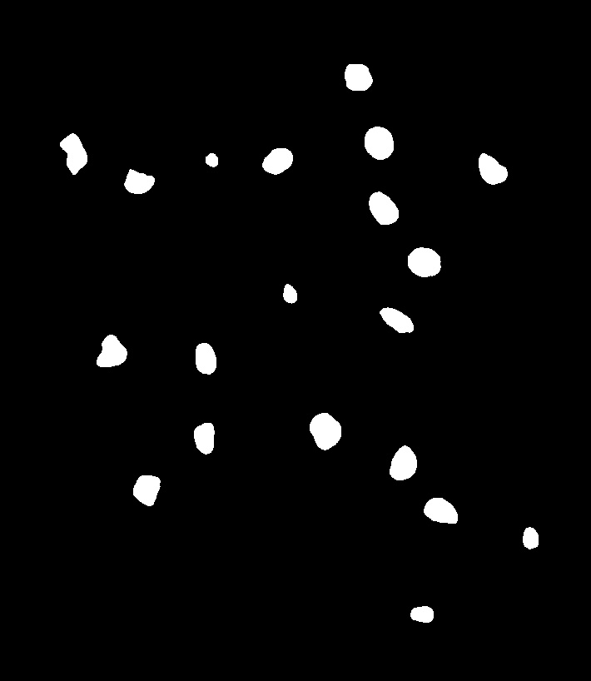
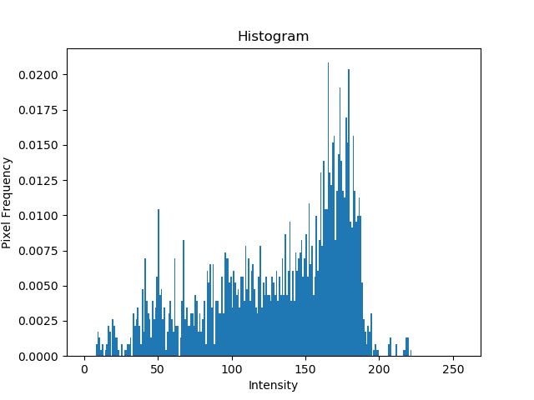
Improvement – Using Edges(Laplacian)
Laplacian
Histogram
Otsu thresholding
( T=115, Sep =0.76)

Slide 22
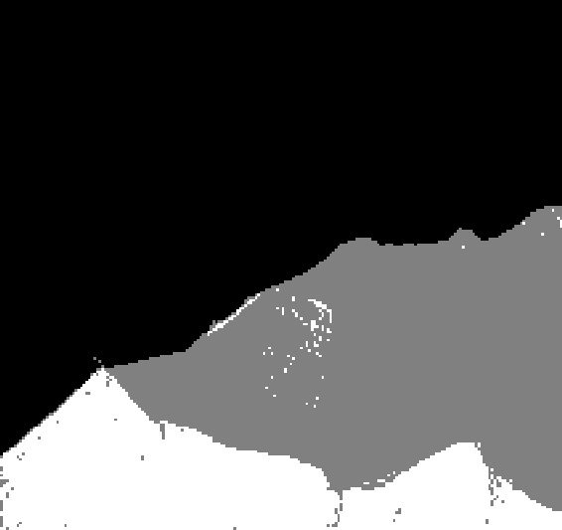
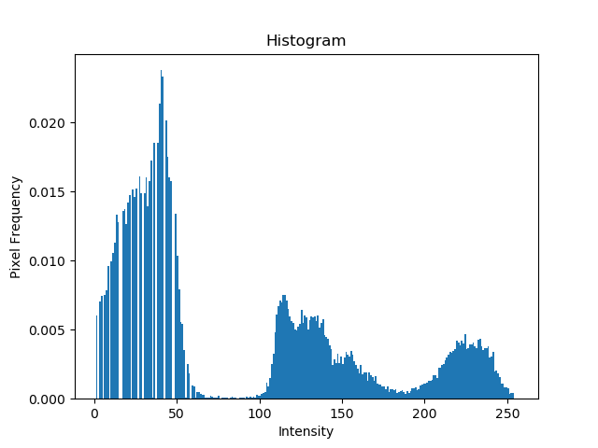
Multiple Thresholding
Original
Histogram
Multiple thresholding

Slide 23
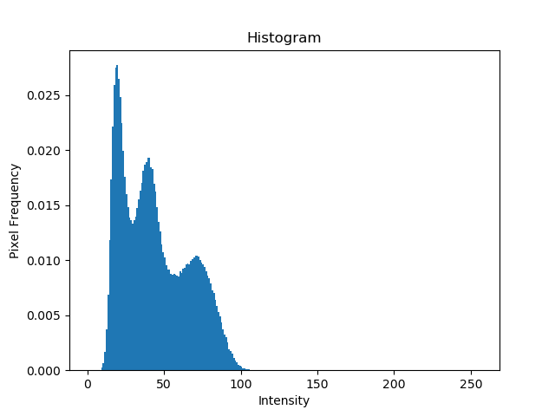
Image Partitioning
Original (Noisy shade)
Histogram

Slide 24
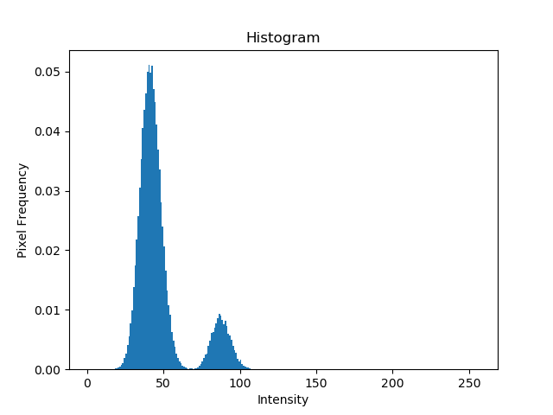
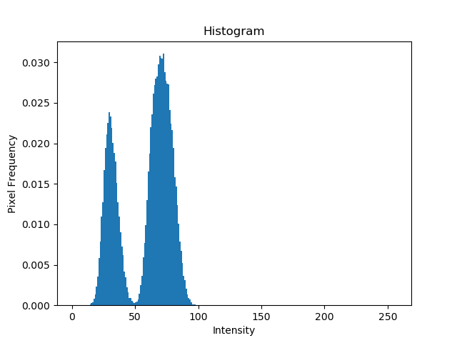
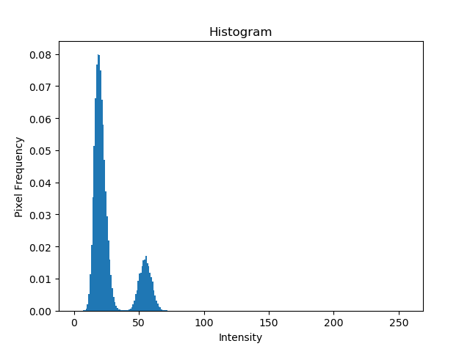
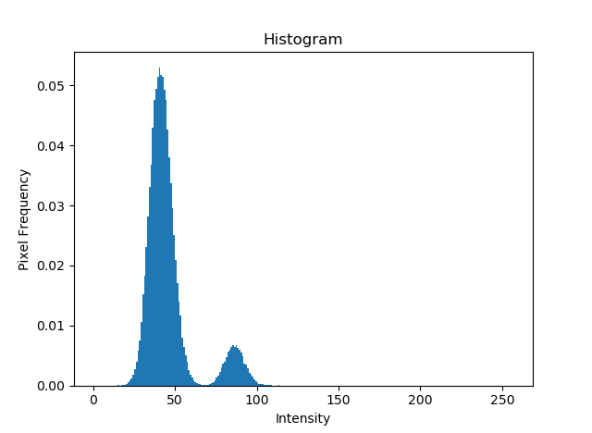

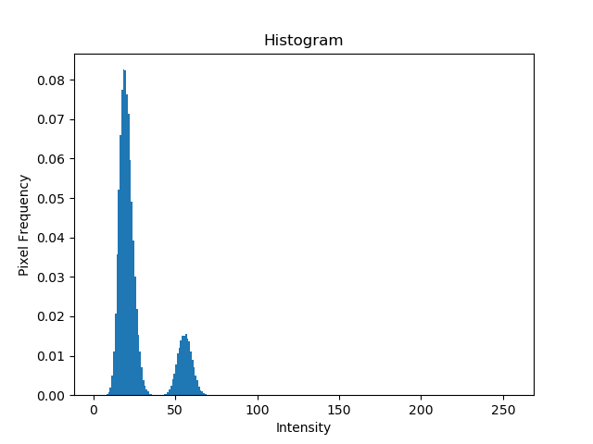
Image Partitioning
T_opt = 40
T_opt = 51
T_opt = 64
T_opt = 38
T_opt = 51
T_opt = 65

Slide 25

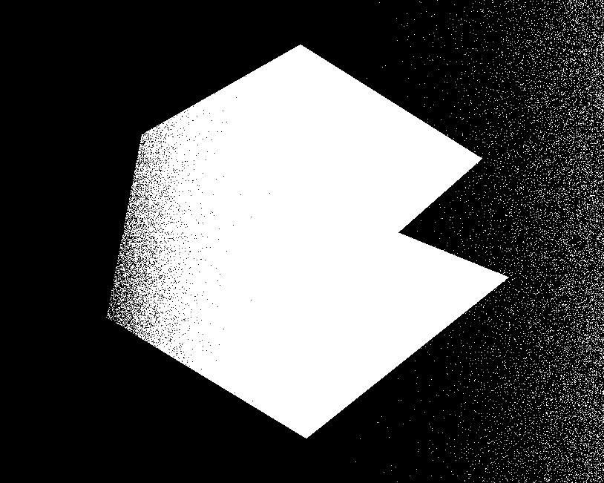

Image Partitioning
Basic Global Thresholding
T= 48.8
Otsu Thresholding
T_opt = 50
Partitioned Thresholding

Slide 26
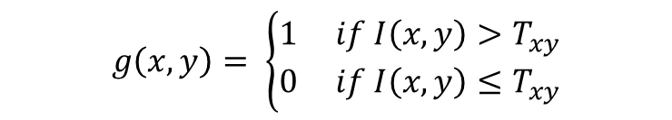
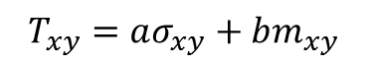
Variable Thresholding(Local properties)
I(x-1,y-1) | I(x,y-1) | I(x+1,y-1)
I(x-1,y) | I(x,y) | I(x+1,y)
I(x-1,y+1) | I(x,y+1) | I(x+1,y+1)
$T_{xy}=aσ_{xy}+bm_{xy}$
$$g\left(x,y\right)= \left\{\begin{aligned}1 if I\left(x,y\right)>T_{xy} \\ 0 if I\left(x,y\right)≤T_{xy}\end{aligned}\right.$$

Slide 27
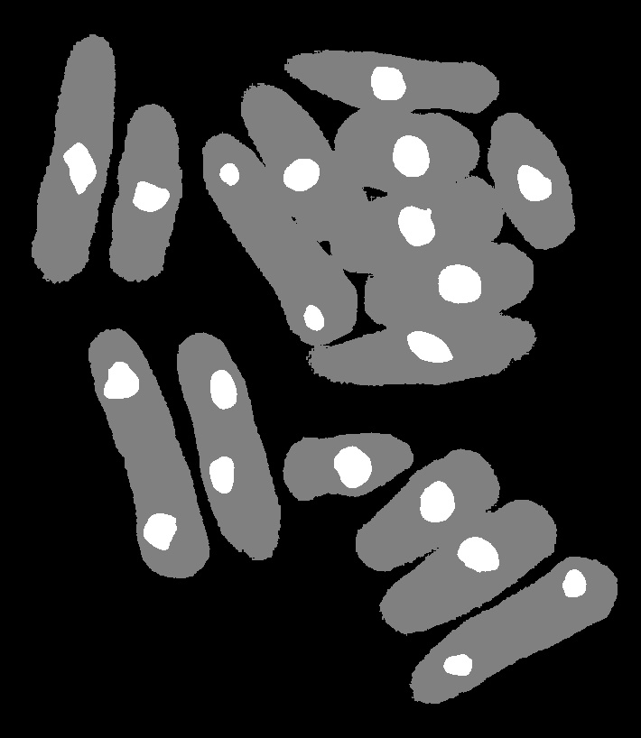
Variable Thresholding(Local properties)
Original
Multiple Thresholding

Slide 28
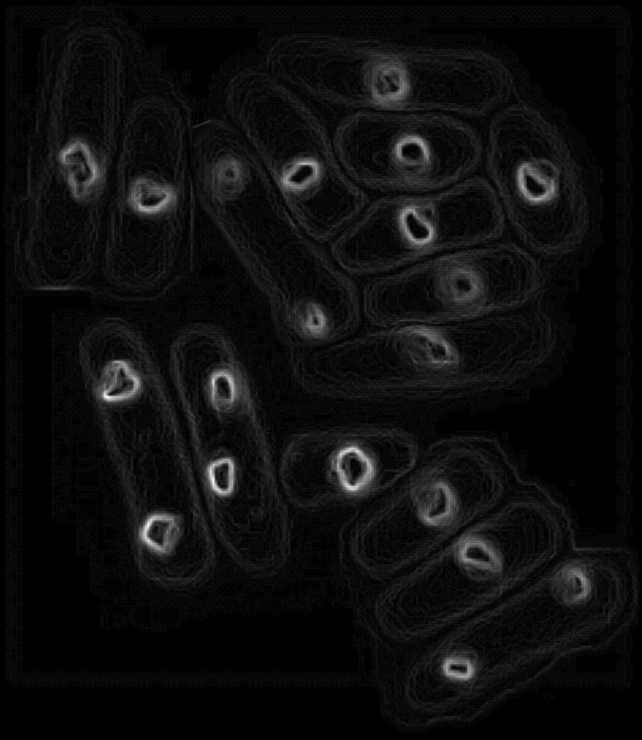
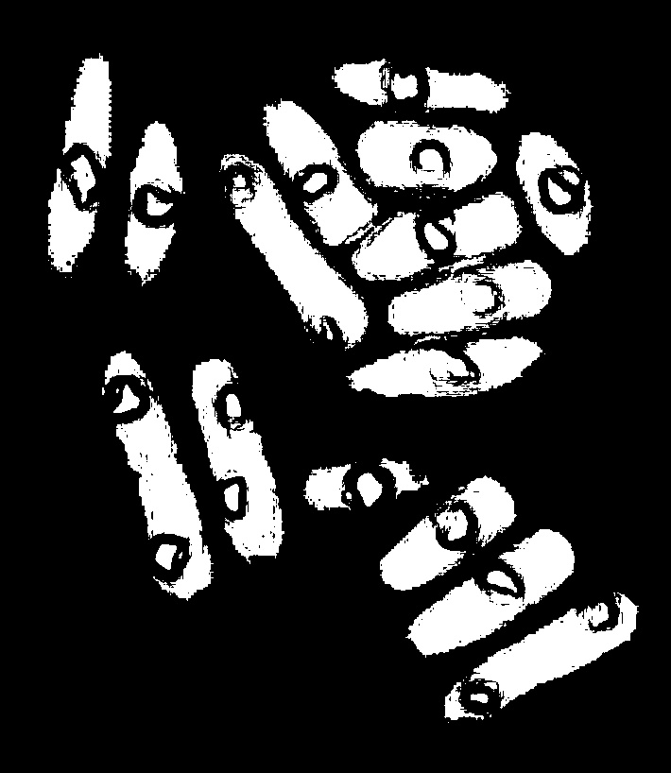
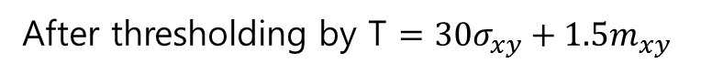
Variable Thresholding(Local properties)
Local variance image (after scaling)
After thresholding by T $=30σ_{xy}+1.5m_{xy}$

Slide 29
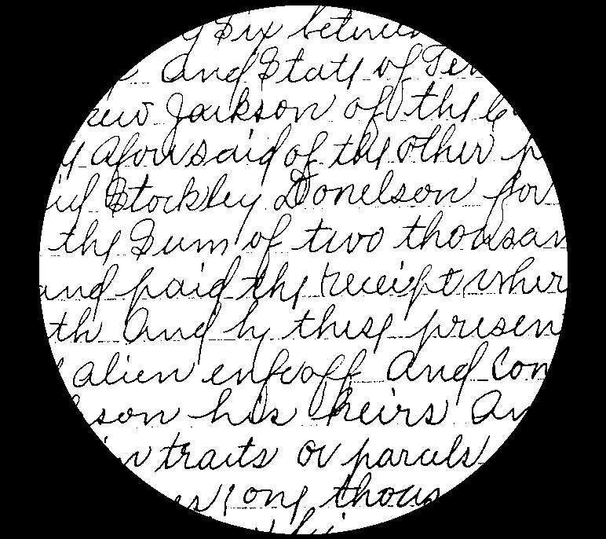

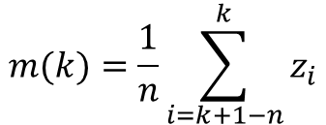
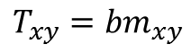
Moving average Thresholding
Original
Otsu
Moving Average Thresholding
n = 20 ,b=0.5
$$m(k)=\frac{1}{n}\sum_{i=k+1−n}^{k}{z_{i}}$$
$$T_{xy}={bm}_{xy}$$

Slide 30

Moving average Thresholding
Original
Otsu

Slide 31





Moving average Thresholding
n=20
b=0.5
b=0.3
b=0.1
n=30

Slide 32
Morphological image processing
※Operate on a Binary image (After thresholding)
False negative
False positive
False positive
cause 2 objects to appear as 1

Slide 33
Morphological image processing
Structuring element :
A small pixel template that helps to produce new image
0 | 1 | 0
1 | 1 | 1
0 | 1 | 0
1 | 1 | 1
1 | 1 | 1
1 | 1 | 1
1
1
1
. . . .
Disk
Square

Slide 34
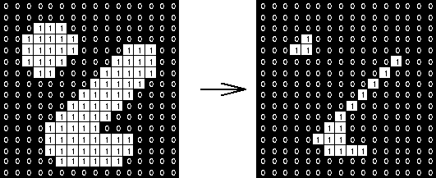
Erosion
1 | 1 | 1
1 | 1 | 1
1 | 1 | 1
3 X 3 square structure
Original
After Erosion

Slide 35

Erosion
Original
3 X 3 Square Erosion

Slide 36



Erosion
5 X 5 Square Erosion
11 X 11 Square Erosion
15 X 15 Square Erosion
45 X 45 Square Erosion

Slide 37

Dilation
1 | 1 | 1
1 | 1 | 1
1 | 1 | 1
3 X 3 square structure

Slide 38

Dilation
Original

Slide 39


Dilation
3 X 3 Disk dilation

Slide 40


Dilation
3 X 3 Square dilation

Slide 41

Opening and Closing
A : Original Image
B : Structure element
Erosion
Dilation after Erosion
Opening
Dilation
Erosion after Dilation
Closing

Slide 42


Opening (3x3 square)
Original
Erosion
Opening(Dilation after Erosion)

Slide 43


Closing (3x3 square)
Opening
Dilation
Closing (Erosion after Dilation)

Slide 44
Opening and Closing
Original
After Opening and Closing

Slide 45


Boundary Extraction
Original
Erosion
Boundary Extraction

Slide 46


Hole filling

Slide 47


Hole filling
$I$(512 x 512)
$$I^{C}$$
Initial F mask

Slide 48



Hole filling
$$I^{C}$$
Initial F mask

Slide 49




Hole filling
F ∩$I^{C} after each dilation of F$
…
$$I^{C}$$
2 Iteration
7 Iteration

Slide 50
Hole filling
50 Iteration
100 Iteration
200 Iteration
255 Iteration

Slide 51
Hole filling
Original image
Inverse after 255 Iteration

Slide 52


Hole filling
$I$(563 x 226)
$$I^{C}$$

Slide 53
Hole filling
50 Iteration
100 Iteration
120 Iteration
Inverse after 120 iteration

Slide 54


Hole filling
$I$(2018 x 918)
$$I^{C}$$

Slide 55
Hole filling
100 Iteration
300 Iteration
500 Iteration
700 Iteration

Slide 56
Super pixel
Definition:
A superpixel can be defined as a group of pixels that share common characteristics
(like pixel intensity)
1.Superpixels have a perceptual meaning since pixels belonging to a given superpixel share similar visual properties.
2.They provide a convenient and compact representation of images that can be very useful for computationally demanding problems

Slide 57
Super pixel
3. Superpixels in the context of Image Segmentation:
Image Segmentation is the process of partitioning an image into multiple segments(set of pixels or superpixels).
4. The goal is to represent the image as something that is more meaningful and easier to analyze. (Process of assigning a label to every pixel in an image such that pixels with the same label share certain characteristics. )

Slide 58
Super pixel
SLIC (Simple Linear Iterative Clustering) Algorithm for Superpixel generation
:Algorithm generates super pixels by clustering pixels based on their color similarity and proximity in the image plane.
This algorithm takes as input a desired number of approximately equally-sized superpixels K.
At the onset of the algorithm, K superpixel cluster centers C_k= [l_k, a_k, b_k, x_k, y_k] are chosen with k= [1,K] at regular grid intervals S.
Since the spatial extent of any super pixel is approximately S²(the approximate area of a super-pixel), it is safely assumed that pixels that are associated with this cluster center lie within a 2S×2S area around the superpixel center on the xy plane.

Slide 59
Super pixel
SLIC (Simple Linear Iterative Clustering) Algorithm for Superpixel generation
This algorithm takes as input a desired number of approximately equally-sized superpixels K.
At the onset of the algorithm, K superpixel cluster centers C_k= [l_k, a_k, b_k, x_k, y_k] are chosen with k= [1,K] at regular grid intervals S.
Since the spatial extent of any super pixel is approximately S²(the approximate area of a super-pixel), it is safely assumed that pixels that are associated with this cluster center lie within a 2S×2S area around the superpixel center on the xy plane.

Slide 60

Super pixel
SLIC (Simple Linear Iterative Clustering) Algorithm for Superpixel generation
 |  |  |  |  |  |  | 8x8
 |  |  | (x,y)
S
2S
2S
K = 64,
N = 512 x 512
S = 8
Cluster a 2S×2S area around the superpixel center

Slide 61

Super pixel
SLIC (Simple Linear Iterative Clustering) Algorithm for Superpixel generation
Deciding initial center seed:
This algorithm begins by sampling K regularly spaced cluster centers and moving them to seed locations corresponding to the lowest gradient position in a 3×3 neighborhood
->This is done to avoid placing them at an edge and to reduce the chances of choosing a noisy pixel

Slide 62

Super pixel
SLIC (Simple Linear Iterative Clustering) Algorithm for Superpixel generation

Slide 63
Super pixel
Image
SLIC (Simple Linear Iterative Clustering) Algorithm for Superpixel generation
 | center 1
 |  |  | current pixel
 |  |  |  |  | center 2
For 512 x 512 image
We need
1.Label matrix(512x512)
-> Initialization = -1
2.D matrix (512x512)
-> Initialization = inf
D1
D2

Slide 64
Super pixel
SLIC (Simple Linear Iterative Clustering) Algorithm for Superpixel generation
1 | 1 | 1 | 1 | 3 | 3 | center3 | 3
1 | 1 | 1 | 3 | 3 | 3 | 3 | 3
1 | 1 | 1 | 3 | 3 | 3 | 3 | 3
1 | center 1 | 1 | 1 | 3 | 2 | 2 | 2
1 | 1 | 1 | 1 | 1 | 2 | 2 | 2
1 | 1 | 1 | 1 | 2 | center 2 | 2 | 2
1 | 1 | 1 | 2 | 2 | 2 | 2 | 2
1 | 1 | 2 | 2 | 2 | 2 | 2 | 2
After labeling
Average all of pixels’ (x,y) coordinate & intensity
which have equal label.
1. Select new center 1,2…,k
2. If Euclidian distance between previous center and new center(E) is small than T,
->Stop algorithm.
Else, repeat labeling process.
D1
D2

Slide 65
Super pixel
SLIC (Simple Linear Iterative Clustering) Algorithm for Superpixel generation
1 | 1 | 1 | 1 | 3 | 3 | center3 | 3
1 | 1 | 1 | 3 | 3 | 3 | 3 | 3
1 | 1 | 1 | 3 | 3 | 3 | 3 | 3
1 | center 1 | 1 | 1 | 3 | 2 | 2 | 2
1 | 1 | 1 | 1 | 1 | 2 | 2 | 2
1 | 1 | 1 | 1 | 2 | center 2 | 2 | 2
1 | 1 | 1 | 2 | 2 | 2 | 2 | 2
1 | 1 | 2 | 2 | 2 | 2 | 2 | 2
After center converges
Compute average intensity of pixels which have same label (1,2…k)
Change each pixel’s intensity to corresponding label’s average value.

Slide 66


Super pixel
Deciding initial center point of each super pixel.

Slide 67
Super pixel
256 64x64 superpixel

Slide 68
Super pixel

Slide 69
Super pixel

Slide 70
Super pixel
64x64 superpixel
32x32 superpixel
16x16 superpixel

Slide 71

Super pixel

Slide 72
Super pixel

Slide 73
THANK YOU for your attention

